Slide 1
Robert Melashenko MD

Slide 2
The schools established among us are matters of grave responsibility; for important interests are involved. In a special manner our schools are a spectacle unto angels and to men. A knowledge of science of all kinds is power, and it is in the purpose of God that advanced science shall be taught in our schools as a preparation for the work that is to precede the closing scenes of earth's history. {CE 83.2}

Slide 3
Human Genome
The Whole Enchilada

Slide 4
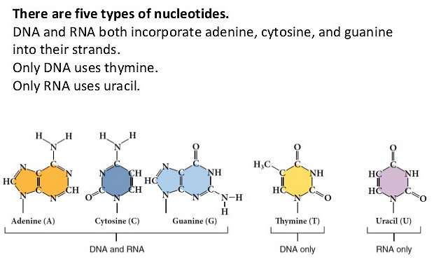

Slide 5
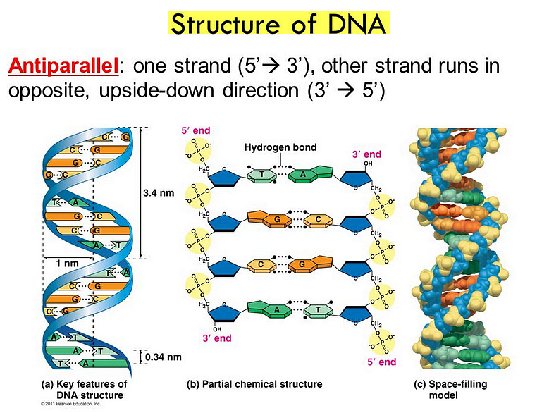

Slide 6
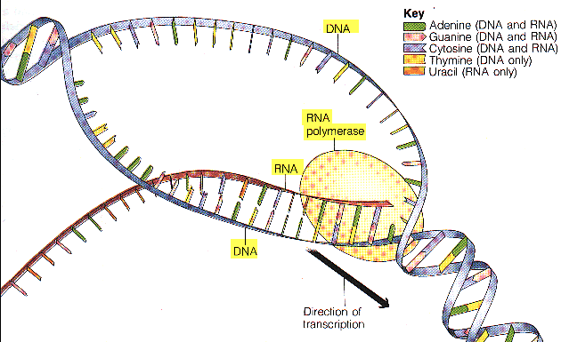
Transcription

Slide 7
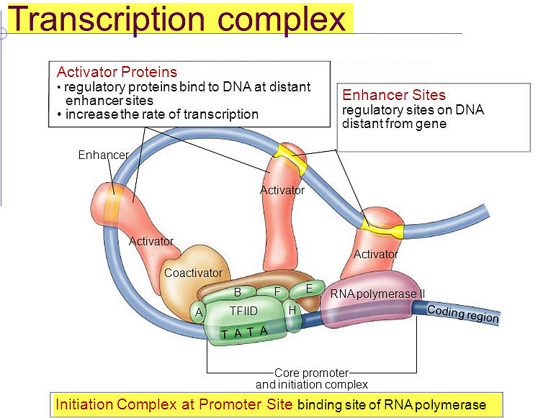

Slide 8
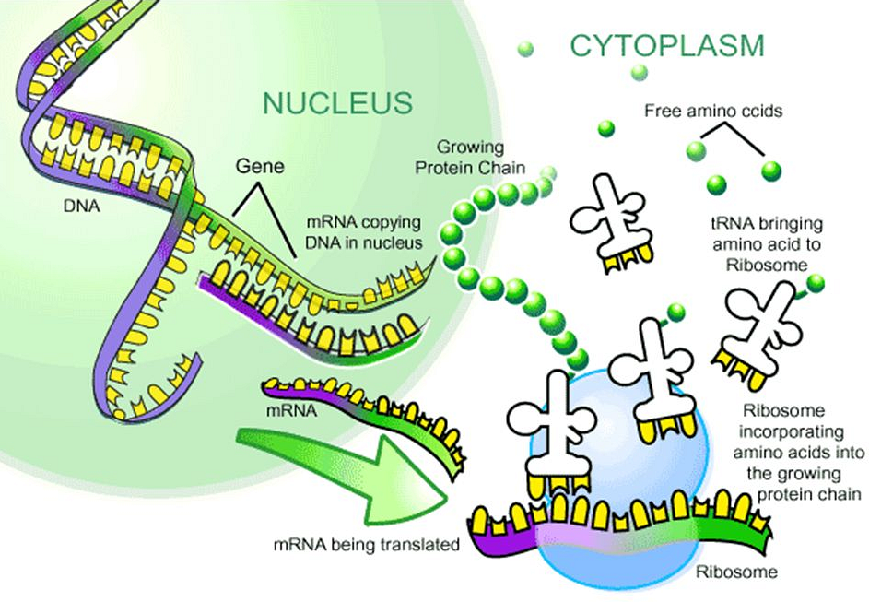

Slide 9
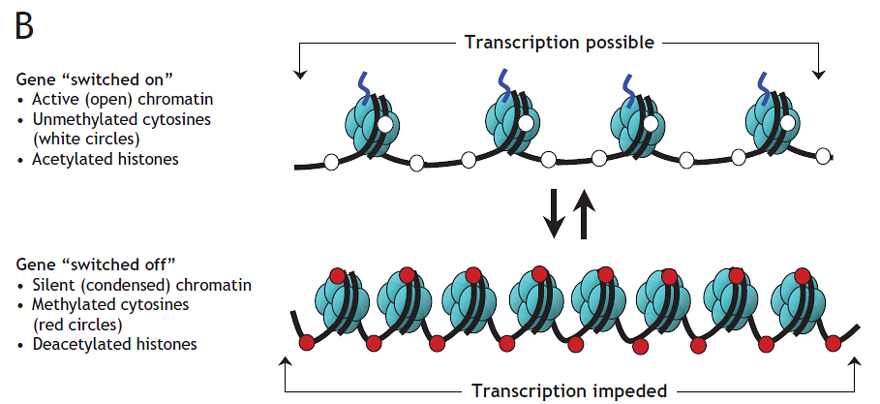

Slide 10
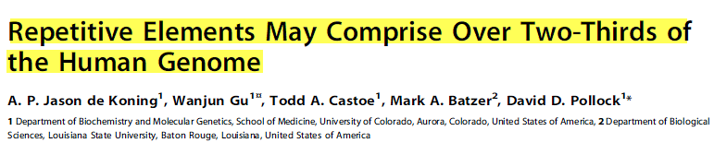
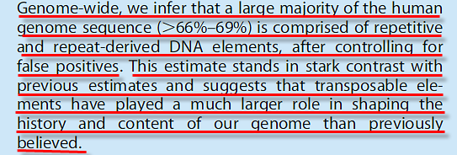
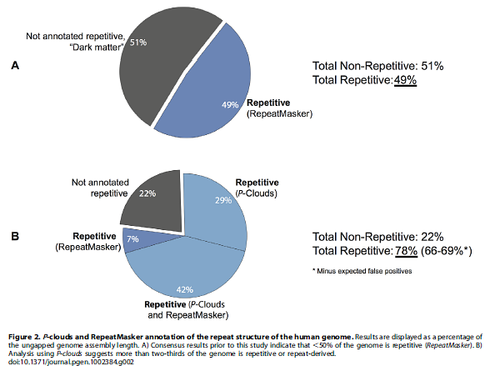
PLoS Genetics | 1 December 2011 | Volume 7 | Issue 12

Slide 11
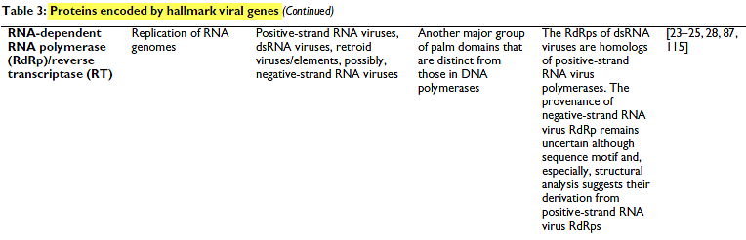
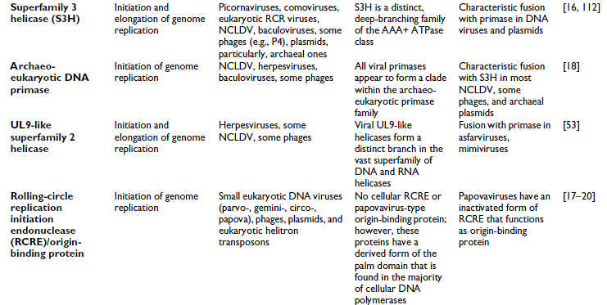
Biology Direct 2006, 1:29

Slide 12
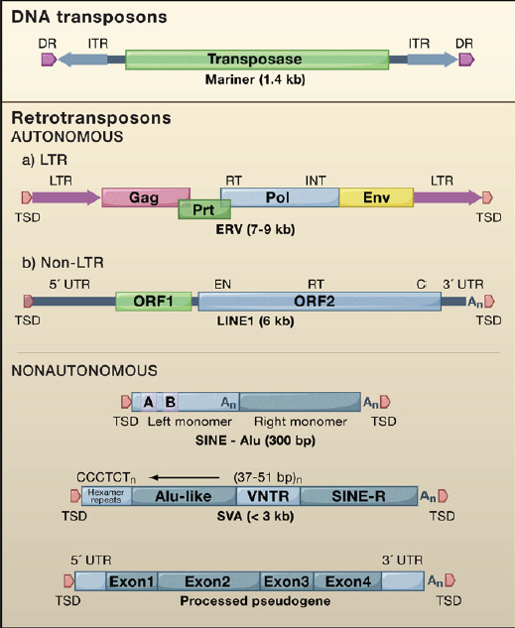
MOBILE GENETIC ELEMENTS MGE’s
Cell 135, October 3, 2008

Slide 13
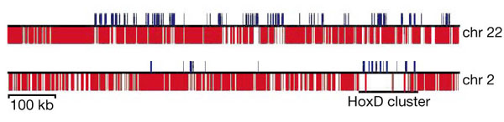
Density of TEs in the human euchromatin
TEs
exons of known genes
TE and exon density in two regions of human chromosomes 2 and 22.
From Figure 21, IHGSP, Nature 409: 860-927 (2001)

Slide 14
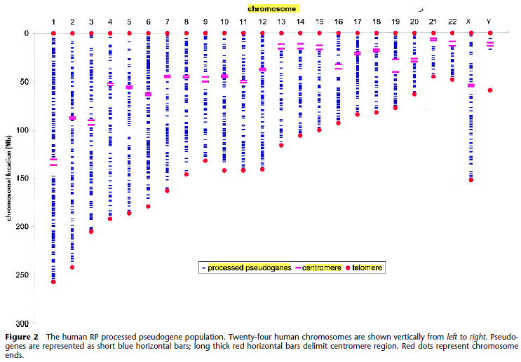
Genome Research 12:1466–1482 ©2002 by Cold Spring Harbor Laboratory Press

Slide 15
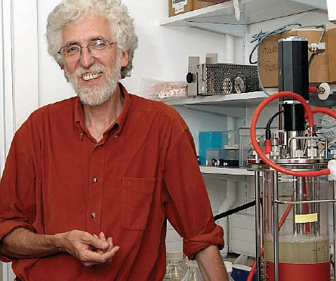
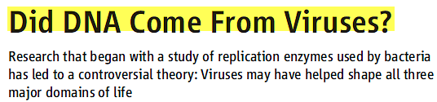

Scientists who deal in the history of life have never been quite sure what to do with viruses. One measure of their uncertainty is the Tree of Life Web Project, a collective effort to record everything known about the relationships of living and extinct species. (www.tolweb.org)
Scientists continued to find more DNA-copying enzymes in viruses that have no counterparts in the world of cells, and Forterre’s suspicions deepened.
12 MAY 2006 VOL 312 SCIENCE

Slide 16
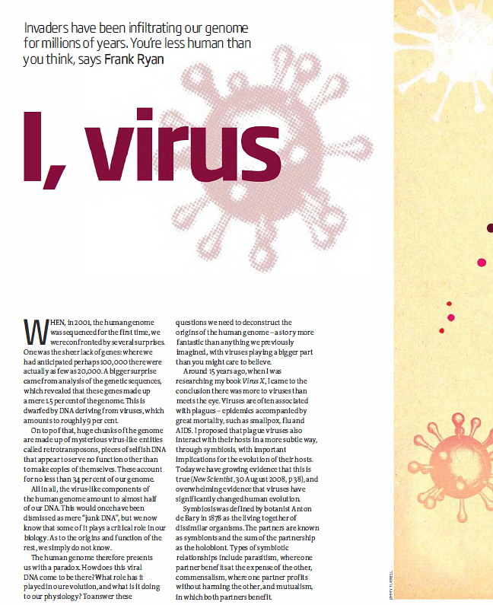
New Scientist 30 January 2010

Slide 17
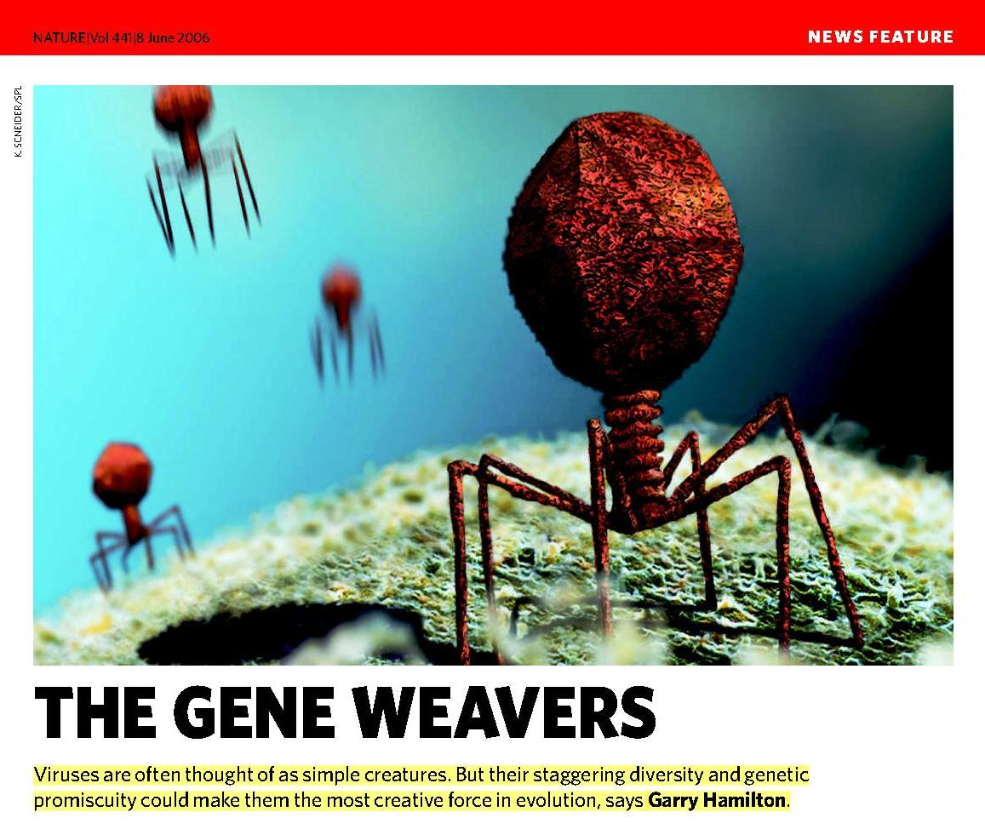

Slide 18
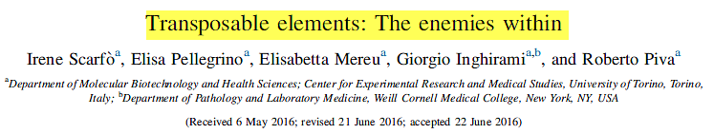
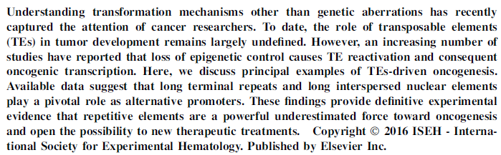
Experimental Hematology 2016;44:913–916

Slide 19
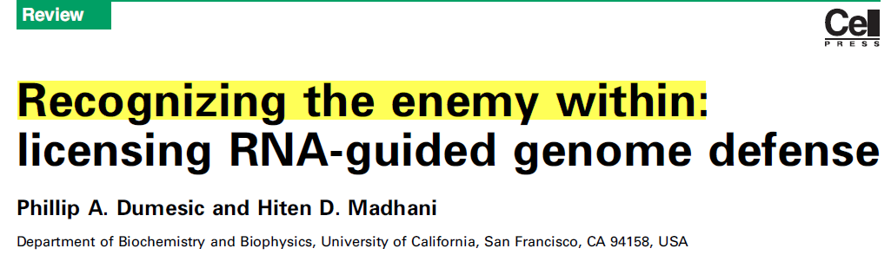
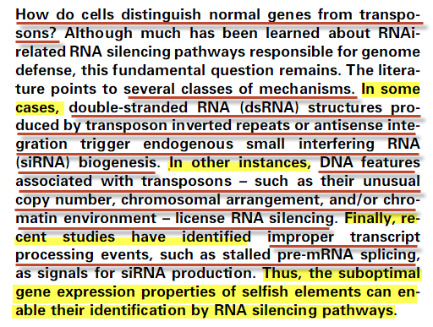
Trends in Biochemical Sciences, January 2014, Vol. 39, No. 1

Slide 20
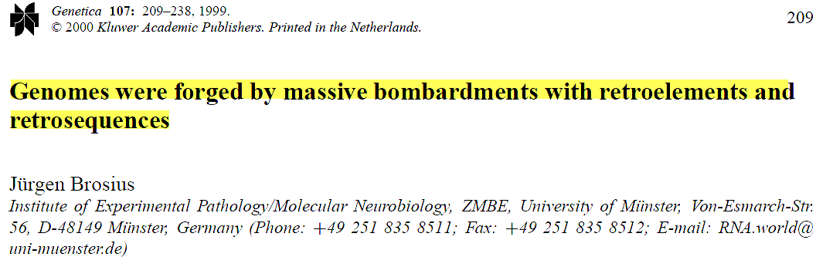


Slide 21
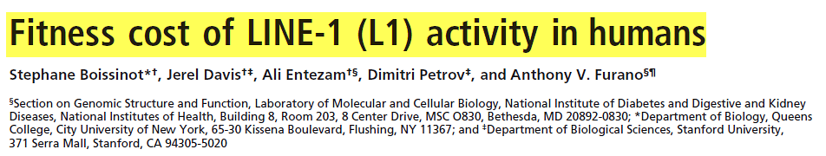
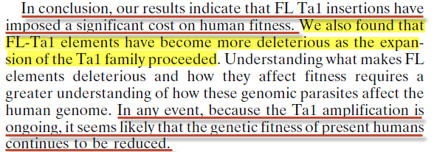
PNAS June 20, 2006 vol. 103 no. 25 9591

Slide 22
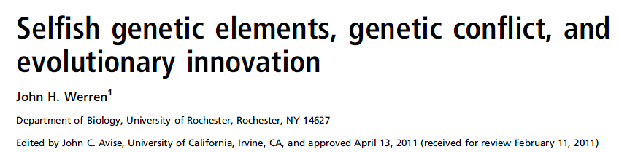
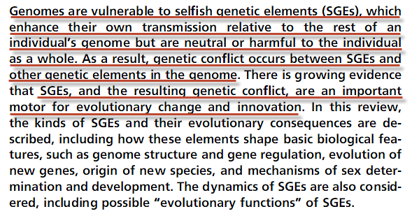
www.pnas.org/cgi/doi/10.1073/pnas.1102343108

Slide 23
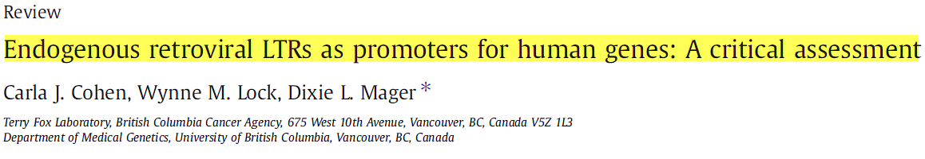
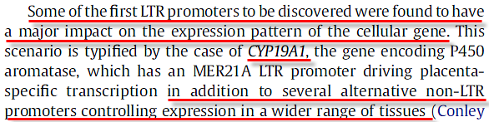
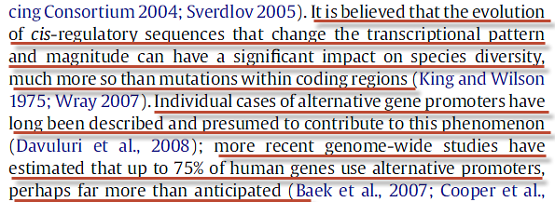
Gene 448 (2009) p105–114

Slide 24
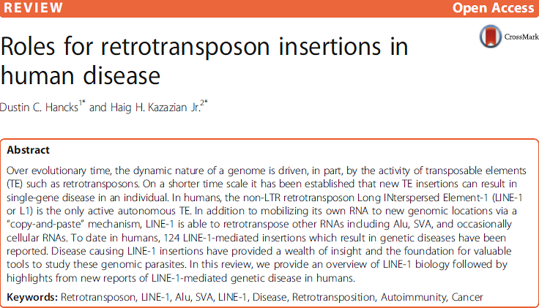
Hancks and Kazazian Mobile DNA (2016) 7:9

Slide 25
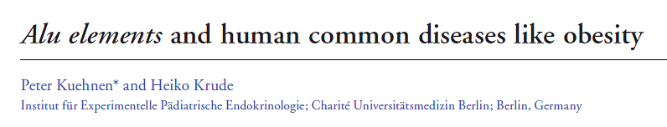
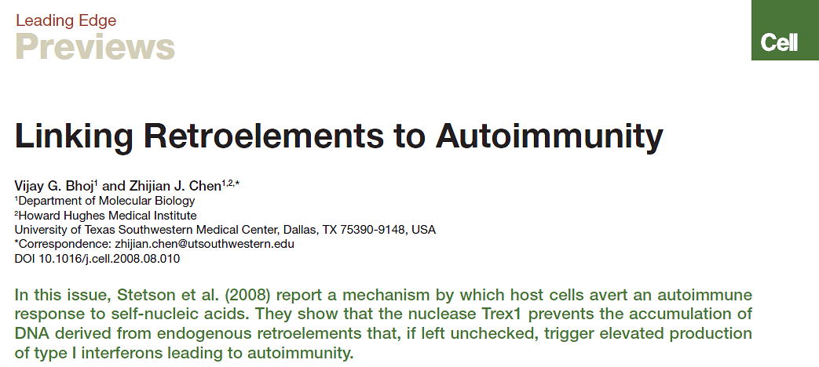
Mobile Genetic Elements 2:4, 197-201; July/August, 2012

Slide 26
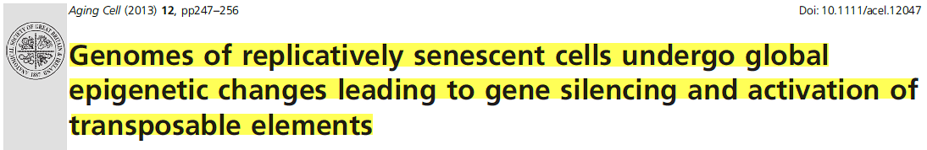
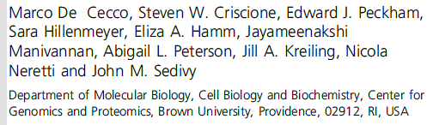
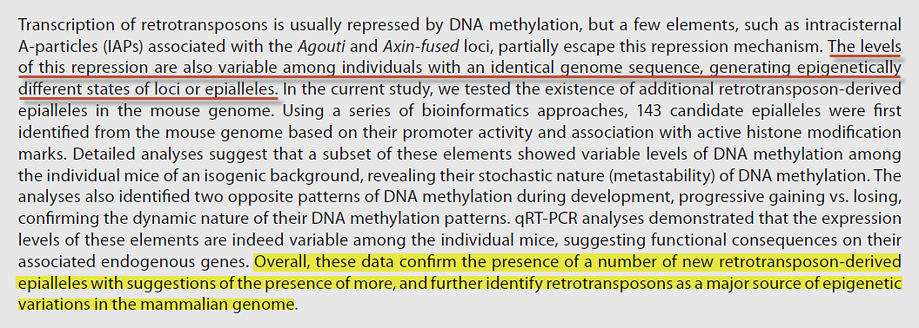
Aging Cell - 2013 Blackwell Publishing Ltd

Slide 27
My transgression is sealed up in a bag, and thou sewest up mine iniquity.
(Job 14:17)

Slide 28
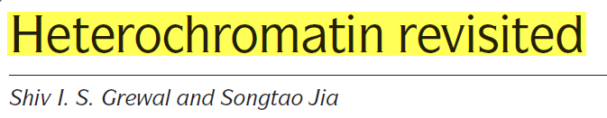
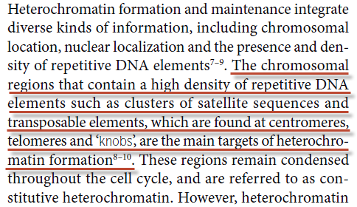
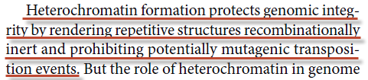
NATURE REVIEWS | GENETICS VOLUME 8 | JANUARY 2007

Slide 29
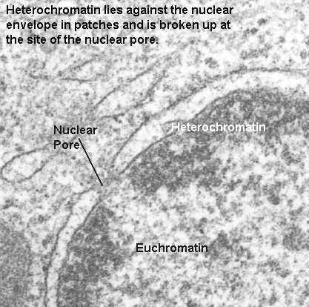
Heterochromatin

Slide 30
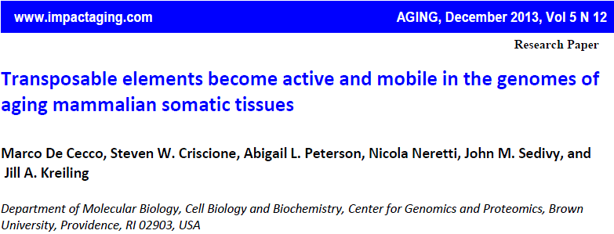

Slide 31
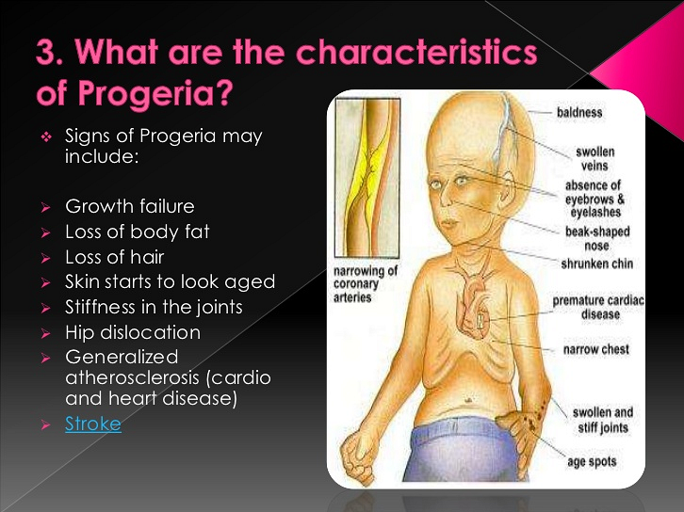

Slide 32
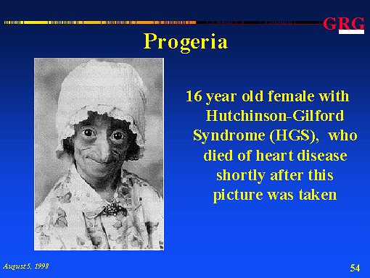

Slide 33
Mat 13:24 Another parable put he forth to them, saying, The kingdom of heaven is likened to a man which sowed good seed in his field:
Mat 13:25 But while men slept, his enemy came and sowed tares among the wheat, and went his way.
Mat 13:26 But when the blade was sprung up, and brought forth fruit, then appeared the tares also.
Mat 13:27 So the servants of the householder came and said to him, Sir, did not you sow good seed in your field? from where then has it tares?
Mat 13:28 He said to them, An enemy has done this.
(AKJV)

Slide 34
For sin pays its wage---death; but God's free gift is eternal life in union with Christ Jesus our Lord.
(Rom 6:23)

Slide 35
But we ourselves have the sentence of death in ourselves, that we should not trust on ourselves, but on God, the One raising the dead,
(2Co 1:9 LITV)

Slide 37
The Human Brain

Slide 38
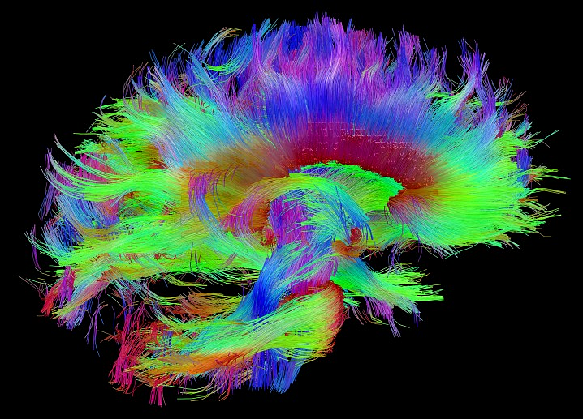
http://www.humanconnectomeproject.org/gallery/

Slide 39
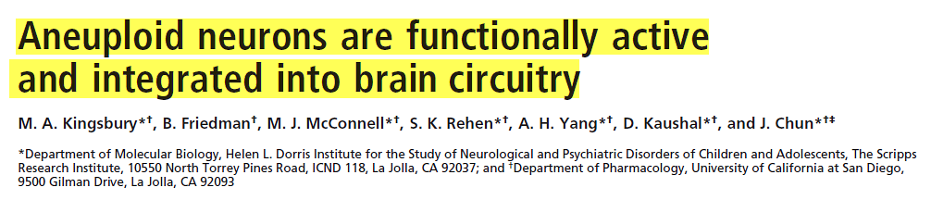
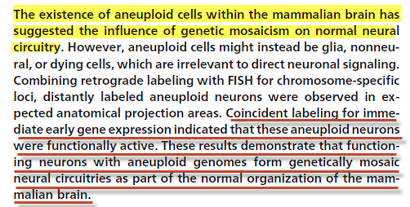
PNAS April 26, 2005 vol. 102 no. 17 6143–6147

Slide 40
From article:
64% of nuclei contained deviations from a euploid karyotype (ref. 16).
PNAS April 26, 2005 vol. 102 no. 17 6143–6147

Slide 41
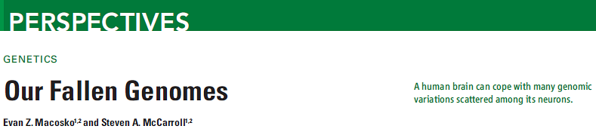
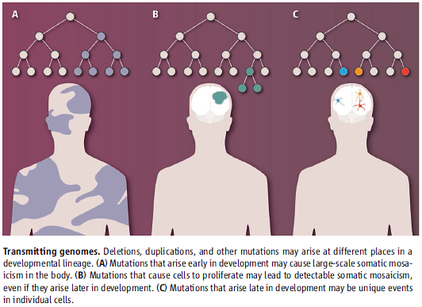
1 NOVEMBER 2013 VOL 342 SCIENCE

Slide 42
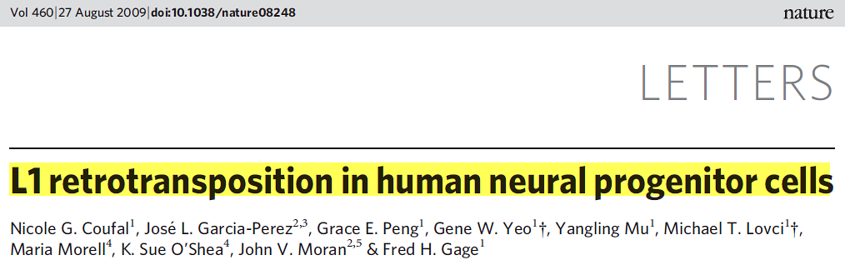
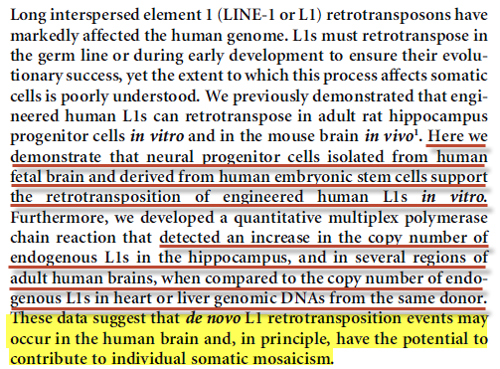

Slide 43


Slide 44

27 Aug 2009 Nature

Slide 45


Slide 46

Transposable Elements Affect Human Behavior!

Slide 47



Genomic distributions of transposon insertions
Human
Chimpanzee
The American Journal of Human Genetics Volume 78 April 2006

Slide 48


Trends in Genetics January 2013, Vol. 29, No. 1

Slide 49

Trends in Genetics January 2013, Vol. 29, No. 1

Slide 50
Because the carnal mind is enmity against God: for it is not subject to the law of God, neither indeed can be. (Rom 8:7)KJV
because the mind of the flesh is enmity towards God; for it is not being subjected to the Law of God, for neither can it be. (Rom 8:7)LITV

